Slide 1
Getting your fix of Unifix
2022 Primary Mathematics Education Conference – Teacher’s Day
Jennifer Bowden &
Dr Paul Swan

Slide 2
If you’ve ever taught in a maths classroom, you’ve most likely stumbled across or used unifix blocks in your teaching. These colourful little blocks are one of the most versatile concrete manipulatives, and can be used in anything from counting to patterns and algebra. In this hands-on workshop, you will be introduced to a variety of activities using unifix, all developed around multiple curriculum content descriptors from Foundation through to Level 6.

Slide 3
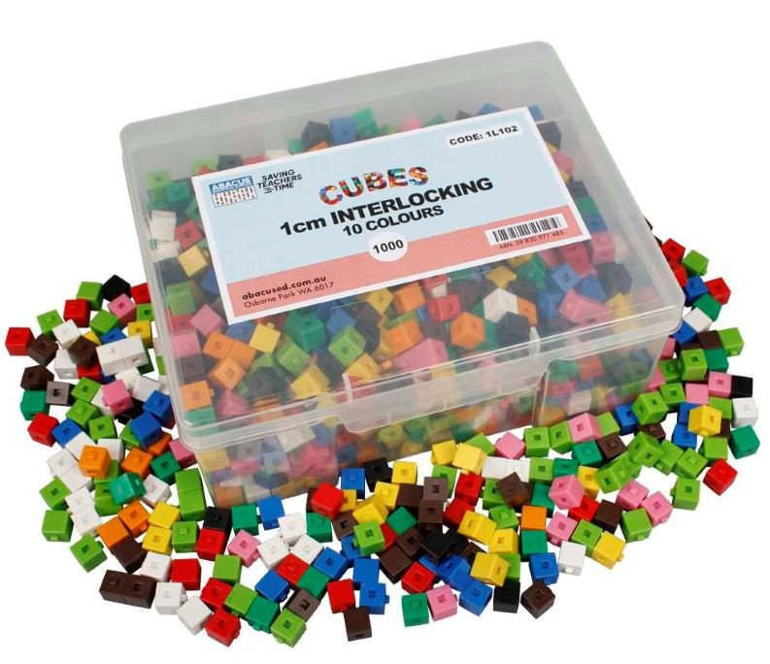
Warm Up
I have a combination of cubes in my hand…. What could they be?

Slide 4
Dr. Paul Swan is an inspirational mathematics consultant from Western Australia, who shares his exciting ideas, videos, and resources on his site.
Many of the resources are free to download and can be implemented in the classroom today.
The topic collections offer support for fostering mathematics literacies to improve communication and vocabulary.
Dr Swan’s many videos highlight and explain how to use hands-on manipulatives in the classroom.

Slide 5
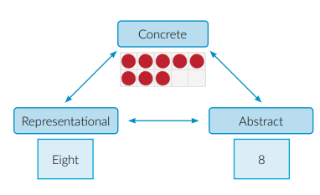

Slide 6
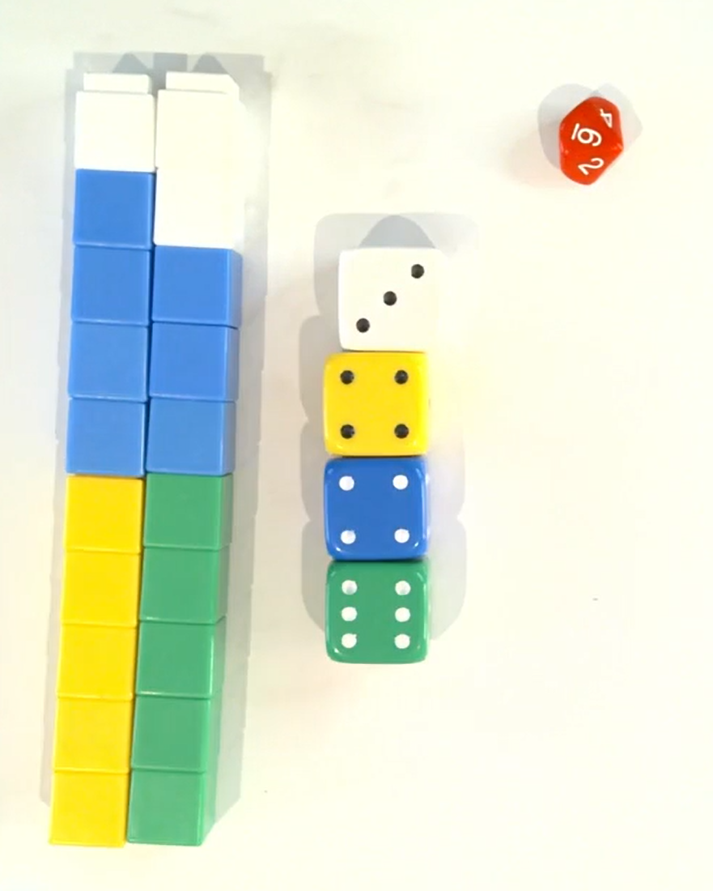
Tower of ten (19.11)
Play as a whole class
Play in groups of three
Variations -
How many ways can you make a Tower of ten using three colours?
What data can we collect?
More than ten?
Different dice?
What is the ideal tower?

Slide 7
Mystery bags (21:05)
Using 10 cubes explore “What’s in the bag?”
How could you use this in your classroom?

Slide 8
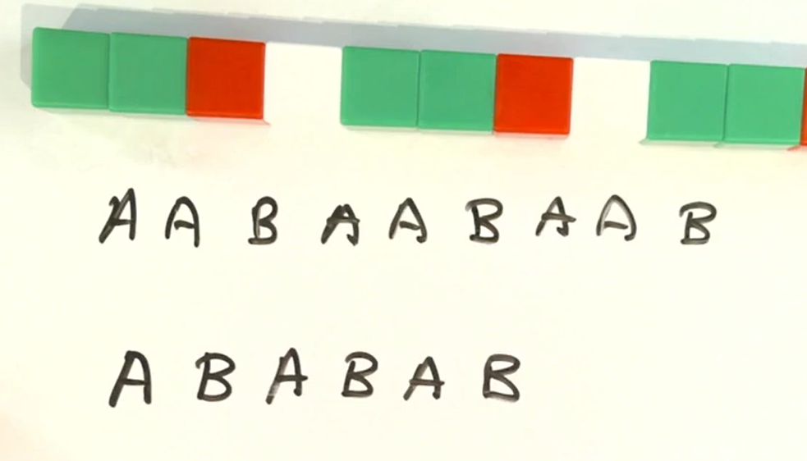
Early Algebra (26:00)
Make a more complex pattern for you group to solve.
As a group try and predict how the pattern ends and test its by “playing” your body percussion.

Slide 9
Ice cream flavours
Explore how many different combinations you can have if you had 4 flavours….
What if you could repeat flavours (eg two scoops of vanilla and two scoops of strawberry).
Combinations and permutations
https://www.mathsisfun.com/combinatorics/combinations-permutations.html

Slide 10
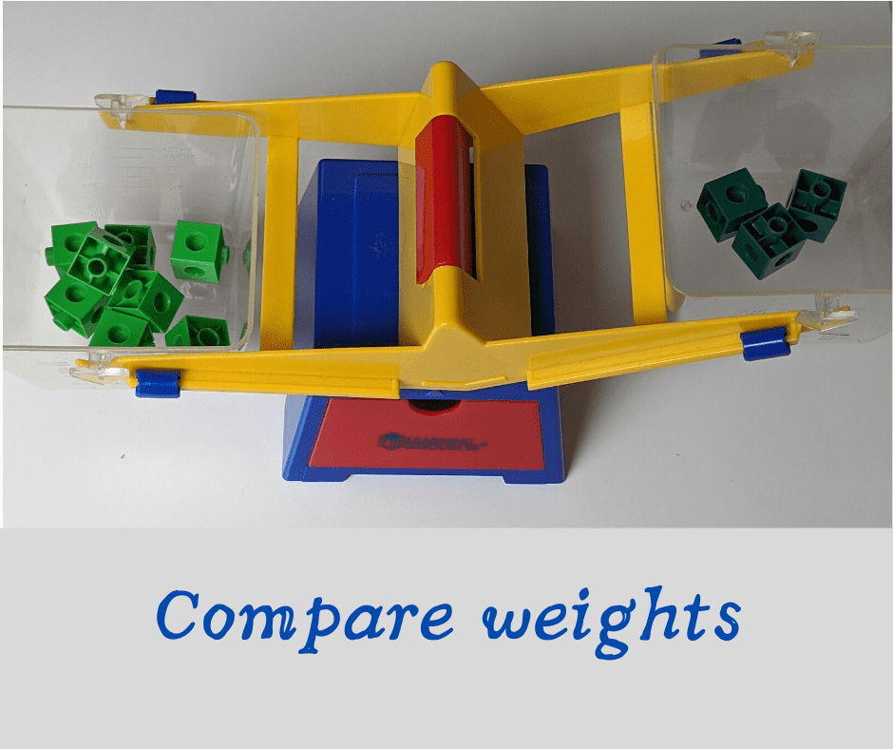
Share
Share a task you have completed (That we haven’t covered!) using unifix cubes.

Slide 11
References
http://mathsmaterials.com/cubes
https://drpaulswan.com.au/wp-content/uploads/2021/08/Guide-to-Teacher-Planning.pdf
https://drpaulswan.com.au/shop/cubes-in-the-classroom/
https://youtu.be/_lMGuifySL4
https://www.mathsisfun.com/combinatorics/combinations-permutations.html

